Slide 1
Transaction Processing Concepts

Slide 2
1. Introduction To transaction Processing
1.1 Single User VS Multi User Systems
  One criteria to classify Database is according to number of user that concurrently connect to the system.
    Single User: only one user use the system in each time
    Multi User: many users use the system in the same time

Slide 3
1.2 Transactions, Read and Write Operations, and DBMS Buffers
What is a Transaction?
  Transaction is an executing program that forms a logical unit of database processing.
  A transaction is a unit of program execution that accesses and possibly updates various data items.
  A transaction include one or more database access operations.
  The database operation can be embedded within an application or can be specified by high level query language.
  Specified boundary by Begin and End transaction statements
  If the database operations in a transaction do not update the database, it is called “Read-only transaction”

Slide 4
Example of transaction
E.g. transaction to transfer $50 from account A to account B:
1. read(A)
2. A := A – 50
3. write(A)
4. read(B)
5. B := B + 50
6. write(B)
Two main issues to deal with:
  Recovery: Failures of various kinds, such as hardware failures
  and system crashes
  Concurrent: execution of multiple transactions

Slide 5
Example of transaction
Let T_{i} be a transaction that transfer money from account A (5000) to account B. The transaction can be defined as
  T_{i}: read (A) (withdraw from A)
    A := A – 5000
    write (A); (update A)
    read (B) (deposit B)
    B := B + 5000
    write (B) (update B)

Slide 6
Example of Fund Transfer
Transaction to transfer $50 from account A to account B:
1. read(A) 2. A := A – 50 3. write(A)
4. read(B) 5. B := B + 50 6. write(B)
Atomicity requirement
  if the transaction fails after step 3 and before step 6, money will be “lost”, leading to an inconsistent database state
    Failure could be due to software or hardware
  the system should ensure that updates of a partially executed transaction are not reflected in the database
Durability requirement — once the user has been notified that the transaction has completed (i.e., the transfer of the $50 has taken place), the updates to the database by the transaction must persist even if there are software or hardware failures

Slide 7
Example of Fund Transfer
Transaction to transfer $50 from account A to account B:
1. read(A) 2. A := A – 50 3. write(A)
4. read(B) 5. B := B + 50 6. write(B)
Consistency requirement in above example:
  the sum of A and B is unchanged by the execution of the transaction
  In general, consistency requirements include
    Explicitly specified integrity constraints such as primary keys and foreign keys
    Implicit integrity constraints
    – e.g. sum of balances of all accounts, minus sum of loan amounts must equal value of cash-in-hand
  A transaction must see a consistent database.
  During transaction execution the database may be temporarily inconsistent.
  When the transaction completes successfully the database must be consistent

Slide 8
Example of Fund Transfer
Isolation requirement — if between steps 3 and 6, another
transaction T2 is allowed to access the partially updated database, it
will see an inconsistent database (the sum A + B will be less than it
should be).
T1 T2
  1. read(A)
  2. A := A – 50
  3. write(A)
        read(A), read(B), print(A+B)
  4. read(B)
  5. B := B + 50
  6. write(B)
Isolation can be ensured trivially by running transactions serially that is, one after the other.

Slide 9
ACID Properties
Atomicity.
  Either all operations of the transaction are properly reflected in the database or none are.
Consistency.
  Execution of a transaction in isolation preserves the consistency of the database.
Isolation.
  Although multiple transactions may execute concurrently, each transaction must be unaware of other concurrently executing transactions.
  That is, for every pair of transactions Ti and Tj , it appears to Ti that either Tj , finished execution before Ti started, or Tj started execution after Ti finished.
Durability.
  After a transaction completes successfully, the changes it has made to the database persist, even if there are system failures.

Slide 10
Failures Type
  Generally classified as
  Transaction Failure
  System Failure
  Media Failure
Notes:
Catastrophe มหันตภัย

Slide 11
Reasons for a transaction fails in the middle of execution
A computer failure (System crash) – media failures
A transaction or system error: logical program error
  Load error or exception conditions detected by the transaction : no data for the transaction
Concurrency control enforcement: by concurrency control method
Disk failure
Physical problems : ex. Power failure, fire, overwrite disk
Notes:
Catastrophe มหันตภัย

Slide 12
Transaction or system error
Some operation in transaction may cause it to fail, such as integer overflow or divide by zero.
User may interrupt during execution

Slide 13
Local error or exception conditions detected by transaction
During transaction execution, conditions may occur that necessitate cancellation of the transaction
Ex. Data for the transaction may not found
Exception should be programmed (not be consider failure)

Slide 14
Concurrency control enforcement
The concurrency control method may decide to abort the transaction,
  Because of violent serializability
  Because several transaction are in state of deadlock
Notes:
สาเหตุจากการควบคุมการทำงานพร้อมกันของรายการเปลี่ยนแปลง
1. ขัดกับ serializability
2.อยู่ในสภาวะล็อกค้าง

Slide 15
Transaction and system concepts
The concept of transaction is fundamental to many techniques for concurrency control

Slide 16
Transaction states and additional Operation
For recovery purpose, the system needs to keep track of when the transaction
  starts,
  terminates,
  and commits or aborts.
What information that the recovery manager keep track?

Slide 17
Transaction states and additional Operation
The recovery manager keep track of the followings
  Begin_transaction: mark the beginning of transaction execute
  Read or write: specified operations on the database item that executes as part of transaction
  End_transaction: specifies that operations have ended and marks the end of execution (Necessary to check)
    The change can be committed
    Or whether the transaction has to aborted
  Commit_Transaction: successful end (will not undo)
  Rollback: unsuccessful end (undone)

Slide 18
State diagram of a transition
Read
Write
Partially
Committed
committed
Commit
Begin
Transaction
Active
Abort
Abort
Failed
Aborted
(Terminate)
A transaction must be in one of these states.

Slide 19
State of transaction
Active
  the initial state; the transaction stays in this state while it is executing
Partially committed
  after the final statement has been executed.
Failed
  after the discovery that normal execution can no longer proceed.
Aborted
  after the transaction has been rolled back and the database restored to its state prior to the start of the transaction.
Two options after it has been aborted:
  restart the transaction
  kill the transaction
Committed – after successful completion
Notes:
Failed กรณีที่มีข้อผิดพลาดเกิดขึ้นกับ transaction

Slide 20
Transaction Model
Operations
  Read(A) – read value of data item A
  Write(A) – write a new value of data item A
  Commit – commit changes of the transaction
  Abort – Revert changes made by the transaction
Data Items
  Objects in the data base
  Usually we consider tuples (rows) or disk page
Notes:
Failed กรณีที่มีข้อผิดพลาดเกิดขึ้นกับ transaction

Slide 21
State of a transition
The transaction has committed
  if it has entered the committed state.
The transaction has aborted
  if it has entered the aborted state.
The transaction is said to have terminated
  if has either committed or aborted.

Slide 22
The System Log
The system maintain log by keep track of all transactions that effect the database.
Log is kept on Disk.
Effected only by disk
Keep Log records

Slide 23
Concurrent Executions
Multiple transactions are allowed to run concurrently in the system.
Advantages are:
increased processor and disk utilization, leading to better transaction throughput
  E.g. one transaction can be using the CPU while another is reading from or writing to the disk
  In multi-processor systems each statement can use one or more CPUs
reduced average response time for transactions: short transactions need not wait behind long ones.
Concurrency control schemes – mechanisms to achieve isolation that is, to control the interaction among the concurrent transactions in order to prevent them from destroying the consistency of the database

Slide 24
Log records
T is transaction ID
(Start_transaction, T) start transaction
(Write_item, T, X, old_value, new_value) transaction write/update item x
(Read_item, T, X) transaction read item X
(Commit, T) complete operation of T
(Abort, T) terminate transaction T

Slide 25
System Log (cont.)
Log file keep track
  start transaction → complete transaction
System fail occur
Restart system, system will recovery
  Redo transaction that already commit
  Undo no commit transaction

Slide 26
Commit point of a transaction
When is the transaction T reach its commit point?
Answer is “when all its operations that access the database have been executed successfully and the effect of all the transaction operations on the database have been recorded in the log.
The transaction is said to be “committed”

Slide 27
(Cont.)
At committed point
  Write [commit] in log file
Failure occur
  Search in log file looking for all transactions T, that have write [Start_Transaction ,T]
  If no commit, Rollback transaction
  If commit found, Redo transaction

Slide 28
Concurrent Executions
Transaction processing permit
  Multiple transactions to run concurrently.
  Multiple transactions to update data concurrently
Cause
  Complications with consistency of data

Slide 29
Reason for allowing concurrency
Improved throughput of transactions and system resource utilization
Reduced waiting time of transactions
Notes:
เพิ่มปริมาณงาน และการใช้ประโยชน์จากทัพยากรของระบบไม่ว่าจะเป็น cpu time ในระหว่างที่มีการอ่านเขียนข้อมูล
หากทำงานในลักษณะทีละรายการรายการที่ตามมาต้องรอจนกว่ารายการ่อนหน้าจะทำงานเสร็จ

Slide 30
Possible Problems
Lost update problem
Temporary update problem
Incorrect summary problem

Slide 31
Example transaction
Transfer money from account A to B
  Read_item(A)
  A := A – 50
  Write_item(A)
  Read_item(B)
  B := B + 50
  Write_item(B)
Transfer 10% of A to Account B
  Read_item(A)
  temp := 0.1*A
  A:= A-temp
  Write_item(A)
  Read_item(B)
  B := B + temp
  Write_item(B)

Slide 32
Lost update problem
A lost update problem occurs due to the update of the same record by two different transactions at the same time.
Lost update problem is a write-write conflict.

Slide 33
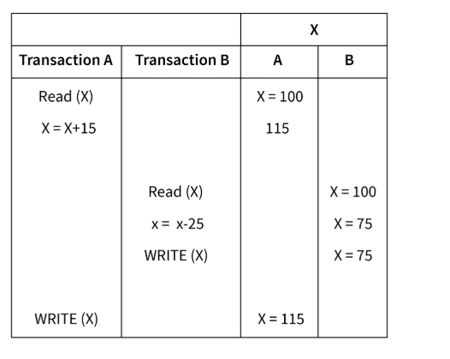
Lost update problem

Slide 34
Lost update problem
X = 100
Transaction A is reading record X = 100 and adding 15 to X, but this transaction is not yet reflected on DB. As write operation is not performed. (Result temp_X = 115)
Transaction B also reads X but here it is not getting updated value after transaction A. Hence, X = 100. Subtracting 25 from X. And write commit operation is performed on X. Hence, X = 75
Write commit operation for transaction A is performed. Hence X = 115
Here, the actual results of transactions A and B should be: X = 100, X after transaction A: X = 115, Transaction B begins: X = 115, X after transaction B: X = 95.
After performing transactions A and B, the value of X should have been X = 95.
But due to a lost update problem the result of Transaction B is lost and the final result is X = 115.

Slide 35
Lost update problem
A = 1000, B =2000
  T1 T2
  Read_item(A)
  A := A – 50
  Read_item(A)
  temp := 0.1*A
  A:= A-temp
  Write_item(A)
  Read_item(B)
  Write_item(A)
  Read_item(B)
  B := B + 50
  Write_item(B)
  B := B + temp
  Write_item(B)
A = 1000
A = 950
A = 1000
temp = 100
A=1000-100
= 900
A = 950
B = 2000
A = 900
B = 2000
B = 2050
B = 2050
B = 2100
B = 2100

Slide 36
Temporary Update Problem:
Temporary update or dirty read problem occurs when one transaction updates an item and fails.
But the updated item is used by another transaction before the item is changed or reverted back to its last value.

Slide 37
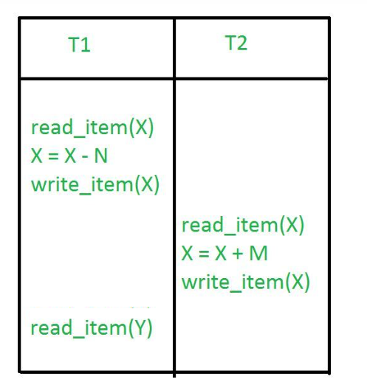
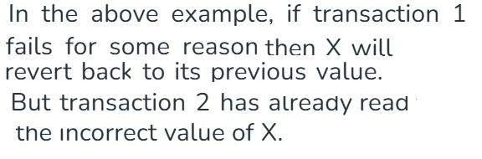
Temporary Update Problem:

Slide 38
Temporary update problem
R = 3000
  T1 T2
  - Write_item(R)
  Read_item(R) -
  - RollBack
R = 1000
R = 1000
R = 3000

Slide 39
Inconsistency problem
Consider a situation, where one transaction is applying the aggregate (sum) function on some records while another transaction is updating these records.
The aggregate (sum) function may calculate some values before the values have been updated and others after they are updated

Slide 40
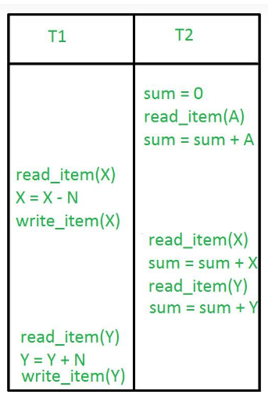
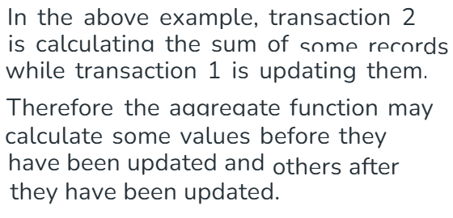
Inconsistency problem

Slide 41
Inconsistency problem
A = 40 , B = 50, C = 30
  T1 T2
  Read_item(A)
  SUM = Sum+A
  Read_item(B)
  SUM = A + B
  Read_item(C)
  C = C - 10
  Write_item(C)
  Read_item(A)
  A = A + 10
  Write_item(A)
  COMMIT
  Read_item(C)
  SUM = SUM + C
A = 40
A+B+C = 40+50+30 = 120
Sum = 40
B = 50
SUM = 40+50
= 90
C = 30
C = 30-10 =20
C = 20
A = 40
After
A+B+C = 50+50+20 = 120
A = 40+10 =50
A = 50
C = 20
Sum = 90 + 20 = 110

